Slide 1
Delta lakes

Slide 2
Pitfalls of data lakes
Lakehouse Architecture
Delta lake capabilities

Slide 3
Delta lakes run on the top of data lake and they are fully compatible with Apache spark API’s

Slide 4
Data warehouse
External data
ETL
Data Warehouse
Operational data
Data consumers

Slide 5
Challenges
Data increased tremendously after 2000.
Wearhouse is not supporting Unstructured data
Data had to be authenticated first and then deploy in production which took long ingestion time.
Proprietary of data formats

Slide 6
Data lake architecture and Pitfalls
No support for ACID transaction
Failed jobs leave partial files
Inconsistent reads
Unable to handle correlations to data
Unable to rollback any data
Lack of ability to remove any data
No history or versioning
Poor performance
Poor BI support
Complex set up
Lambda architecture for streaming workload

Slide 7
Lake House Architecture benefits
Delta lake is with ACID architecture
Handles all types of data
Cheap cloud object storage
Uses open source format and uses parquet files
Supports all types of workload
Provides ability to use BI tools directly
Can maintain history & version
Better performance
Simple Architecture.

Slide 8
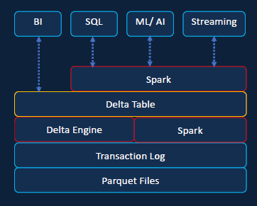
Stores the data in parquet files
While storing parquet delta lake create the transaction log
Delta engine and spark
Delta table
Spark workload like SQL, ML/AI, Streaming
Power BI

